Slide 1

Grocery Store Management System

Slide 2
About me
Our Team
Name : Shaik Suleman
Education : Btech(IT)
Linkedln :www.linkedin.com/in/shaiksuleman123
Name : L Bharadwaja
Education : Btech(MECH)
Linkedln :https://www.linkedin.com/in/lingineni-bharadwaja

Slide 3
Agenda
Project Objective & Domain Overview
Database Schema & ER Diagram
Customer Insights
Product Performance
Sales & Order Trends
Supplier Contribution
Employee Performance
Order Details Deep Dive
Key Findings & Conclusion
Challenges Faced

Slide 4
Project Objective
Domain Overview
The Retail & Grocery domain requires managing inventory, suppliers, customer orders, employees, and product categories. Effective SQL-driven data management enables businesses to track sales, monitor product availability, analyze customer behaviour, and improve operational efficiency.
Project Goals
Design and implement a normalized relational database for a grocery store (7 tables)
Write SQL queries to retrieve, aggregate, and analyze transactional data
Perform business analysis: identify top customers, best-selling products, revenue trends
Evaluate supplier contribution, employee performance, and order-level pricing behavior
Practice JOINs, GROUP BY, subqueries, window functions, and CASE statements

Slide 5
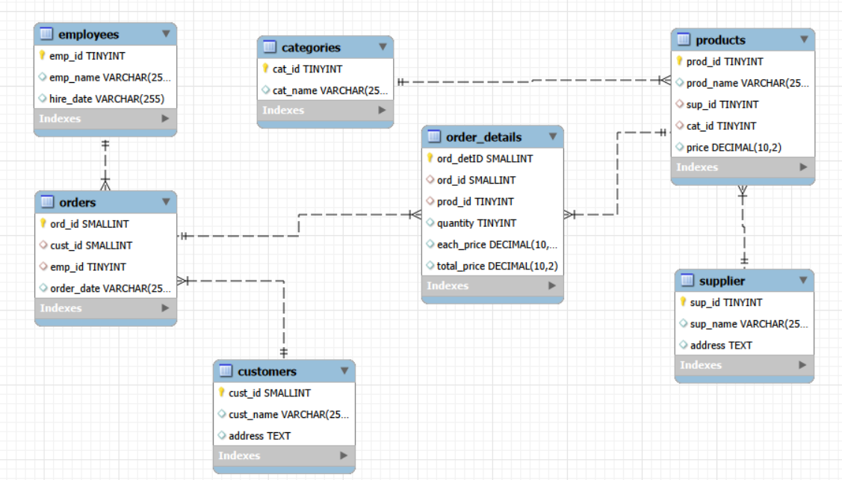
ER DIAGRAM

Slide 6

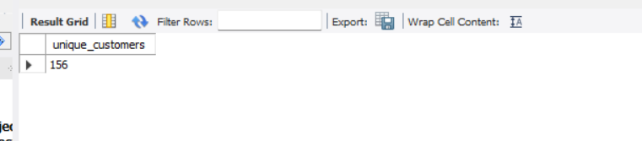
How many unique customers have placed orders?
SQL Query
Result
Result: 156 unique customers have placed at least one order
Approach
Use COUNT(DISTINCT cust_id) on the orders table
DISTINCT ensures each customer is counted once regardless of order frequency
Key Insights
156 unique customers indicates strong customer base and engagement
Not all registered customers may have ordered — gap worth investigating
Baseline metric for customer acquisition and retention tracking

Slide 7
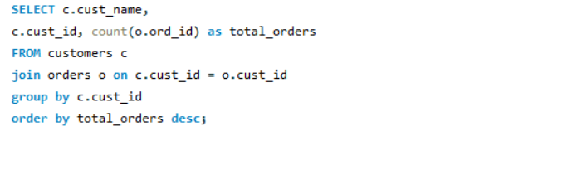

Which customers placed the highest number of orders?
SQL Query
Result
Result: Jyotika placed the highest number of orders (7 orders)
Approach
JOIN customers with orders on cust_id
COUNT(*) for order frequency per customer
ORDER BY DESC to rank from highest to lowest
Key Insights
Jyotika (7 orders) represents the most loyal, high-frequency customer
Frequent buyers are prime candidates for loyalty programs and early access offers
Monitoring top customers helps predict demand and personalize engagement

Slide 8
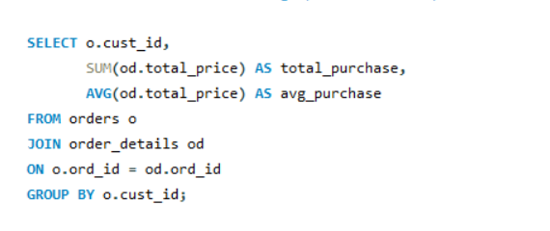
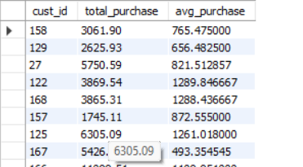
What is the total and average purchase value per customer?
SQL Query
Result
Approach
3-table JOIN: customers → orders → order_details
SUM(total_price) for lifetime value; AVG for basket insight
GROUP BY customer name to get per-customer breakdown
Key Insights
Total purchase value identifies high-value customers worth retaining
Average purchase reveals basket size — large avg = higher spend per visit
Customers with high total but low avg placed many small orders (frequency buyers)

Slide 9
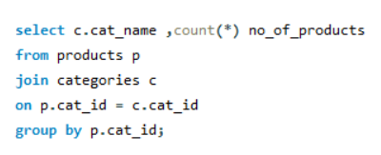
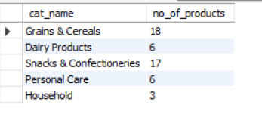
How many products exist in each category?
SQL Query
Result
Result: Grains & Cereals (18), Snacks & Confectioneries (17), Household (3 — lowest)
Approach
JOIN categories with products on cat_id
COUNT(prod_id) grouped by category name
ORDER BY DESC to see largest categories first
Key Insights
Grains & Cereals dominates the catalog with 18 products
Household has only 3 products — a significant gap and expansion opportunity
Uneven distribution may affect customer choice in underrepresented categories

Slide 10
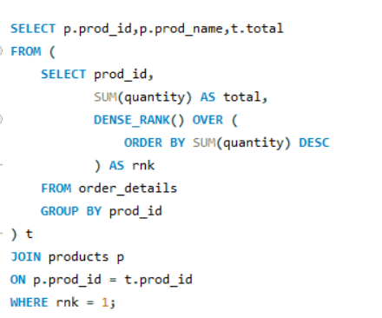

Which products have the highest total sales volume (by quantity)?
Approach
JOIN products with order_details on prod_id
SUM(quantity) to get total units moved per product
DENSE_RANK() can identify top-N without gaps in ranking
Key Insights
Bath Soap (60 units) is the highest-demand product by volume
High-volume products need stronger inventory replenishment planning
Sales volume leaders are not always the highest revenue generators
SQL Query
Result
Result: Bath Soap ranks #1 with 60 units sold in total

Slide 11
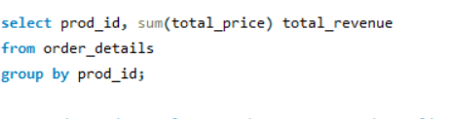
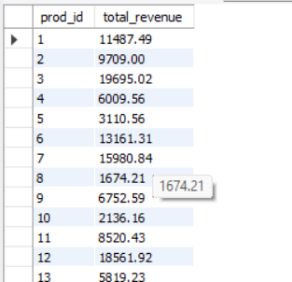
What is the total revenue generated by each product?
SQL Query
Result
Result: High-priced items (Ghee ₹487, Paneer ₹484) rank highest in revenue
Approach
SUM(total_price) per product gives lifetime revenue contribution
Compare with volume rankings to find high-value vs high-volume split
Key Insights
Revenue leaders are premium-priced products, not just high-volume ones
Products like Ghee and Paneer command higher per-unit prices
Balancing volume and revenue helps optimize promotional pricing strategies

Slide 12
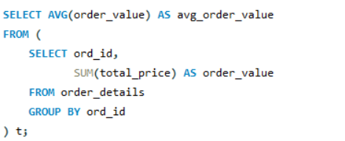

What is the average value per order ?
SQL Query
Result
Result: Average order value reveals typical basket size per transaction
Approach
Subquery: SUM(total_price) per ord_id in order_details
Outer query: AVG over all order totals
Two-step aggregation — critical for accurate per-order averaging
Key Insights
Average order value is a key retail KPI for measuring basket size
Targeted promotions can increase AOV (bundle offers, minimum order thresholds)
Comparing AOV by customer segment reveals spend behavior differences

Slide 13
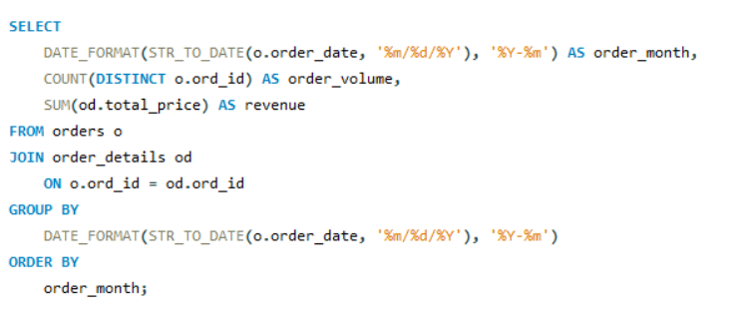
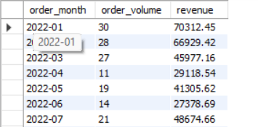
What are the monthly trends in order volume and revenue?
SQL Query
Result
Result: December = highest orders (32); January = highest revenue (₹70,312)
Approach
SUBSTRING(order_date,1,7) extracts YYYY-MM from VARCHAR date
JOIN orders with order_details to get revenue per month
GROUP BY and ORDER BY month for chronological trend view
Key Insights
December peaks in volume — festive/holiday season demand spike
January highest in revenue — possibly higher-priced purchases post-holiday
April and October showed weakest performance — opportunity for promotions
Revenue does not always track with order count — basket size varies by month

Slide 14
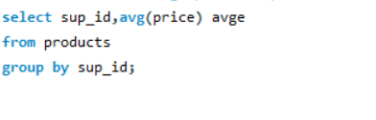
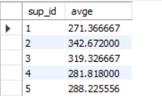
What is the average product price per supplier?
SQL Query
Result
Result: Significant variation in avg price across suppliers reveals product tier differences
Approach
JOIN products with supplier
AVG(price) per supplier to measure typical price point
ORDER BY DESC shows premium suppliers at the top
Key Insights
Suppliers with high avg price deal in premium or specialized products
Price-per-supplier comparison guides negotiation and margin planning
Lower avg-price suppliers may offer volume-friendly, budget-tier products

Slide 15
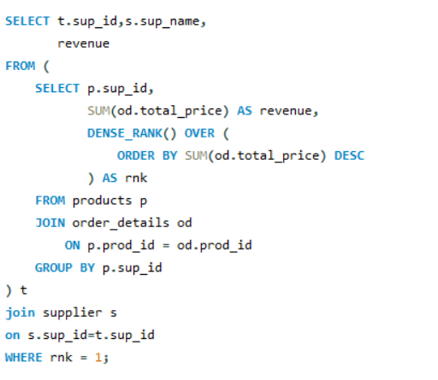

Which suppliers contribute the most to total product sales?
SQL Query
Result
Result: Aarya contributes the highest revenue at ₹2,21,137 — clearly dominant
Approach
JOIN products → supplier + products → order_details
SUM(total_price) per supplier for lifetime revenue contribution
ORDER BY DESC reveals the supplier revenue hierarchy
Key Insights
Aarya accounts for the largest share of revenue — a mission-critical supplier
High revenue contribution does not always equal highest product count
Maintaining strong Aarya relationship is essential for business continuity
Other suppliers may be underpenetrated — opportunity to push more of their products

Slide 16
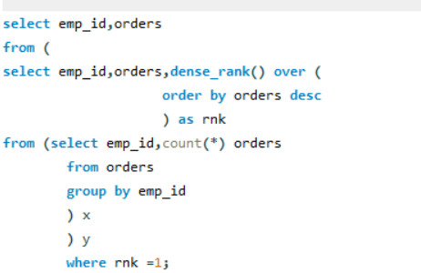

Which employees have handled the most orders?
SQL Query
Result
Result: Diya Sharma handled the most orders (38);
Approach
JOIN employees with orders on emp_id
COUNT(ord_id) per employee for workload measurement
ORDER BY DESC ranks employees by order volume
Key Insights
Diya Sharma and Aditya Singh are the highest-volume processors
Order volume is fairly distributed among top employees — balanced workload
High order handlers may benefit from performance bonuses and recognition

Slide 17
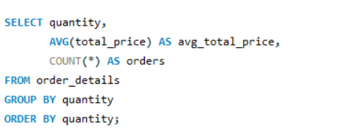
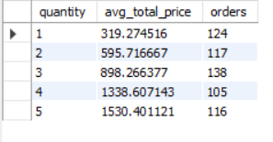
What is the relationship between quantity ordered and total price?
SQL Query
Result
Result: All records show price_check = 'Correct' — pricing is fully consistent
Approach
Calculate expected_total = each_price × quantity
CASE statement compares computed vs stored total_price
Flags any discrepancy as 'Not Correct' for data audit purposes
Key Insights
100% price consistency validates data integrity across all order lines
No hidden discounts or pricing anomalies detected in the dataset
This audit technique is reusable for ongoing data quality monitoring

Slide 18
Challenges Faced
Multi-table JOINs: Understanding relationships across 7 tables and applying the correct JOIN logic for each business question.
FK Constraints: Ensuring CASCADE rules on all foreign keys while maintaining data integrity during inserts and updates.
Complex Aggregations: Writing aggregations (SUM, AVG, COUNT) across deeply joined tables without double-counting order details.
VARCHAR Dates: order_date stored as VARCHAR — required SUBSTRING() for month extraction and DAYOFWEEK(DATE()) for weekday logic.
Window Functions: Applying DENSE_RANK() correctly to rank customers, employees, and suppliers without gaps in ranking.
Validating Results: Cross-checking total_price = each_price × quantity for all records to confirm data accuracy.
Insight Interpretation: Translating raw query outputs into meaningful business recommendations rather than just reporting numbers.

Slide 19
Conclusion
This project successfully leveraged SQL to design a robust Grocery Store Management Database and transform transactional data into actionable business insights. By building 7 interrelated tables and writing analytical queries across 6 business domains, we gained a comprehensive view of customer behaviour, product performance, sales trends, supplier contribution, and employee efficiency.
The analysis demonstrates how structured query language — combined with joins, aggregations, window functions, and conditional logic — can drive data-driven decision-making in a retail context. Every insight derived directly supports real business actions: targeted loyalty programs, smarter inventory planning, supplier negotiations, and employee performance management.
Bottom Line
SQL is not just a querying tool — it is the foundation of business intelligence. This project proves that even a small, well-designed database can unlock powerful, data-driven insights when the right questions are asked.

Slide 20

THANK YOU

